Slide 1

Next Steps with AI
Dr. Amy Mancini, Dean of Arts, Sciences, and Business
NeASFAA Conference
March 27, 2025

Slide 2
Using AI in Higher Education
60% of higher ed leaders and faculty say their institutions regularly use AI tools
79% express positive feelings about using AI tools in the classroom
Shifts are happening from AI detection to transparency in use
A 2023 study predicted a 35-47% salary increase for those who can use AI to excel

Slide 3
Next Steps in Using AI
Assistants:
Otter.ai and Claude
Maximizing Integrated Features:
Office Products

Slide 4

Transcribing In-Person
Otter.ai
    Transcribe meetings with multiple speakers in real time
    Identify speakers by name
    Receive a summary of the meeting
    Receive a report on % of time spent talking
    Receive action steps
    Send/share transcripts and summaries with others by email
    Free subscription gives you hundreds of minutes per month

Slide 5
Creating Powerful Prompts
Give
Give it a role
College student
Accountant
Researcher
Assistant
Define
Define a goal
Write an email
Proofread my writing
Compose a thank you
Create a social media post
Set
Set Restrictions
Use a formal tone
Add detail/make concise
Be professional
Use a variety of sentence structures
Name
Name a format
Answer in bullet points
Use emojis (don't use emojis)
Include a table
Create a single paragraph
Job applicant

Slide 6
SUPER
Powerful Prompts
Correct my mistake:
I made a mistake while practicing how to format a pivot table in Excel. Can you explain what went wrong and how I can avoid making the same mistake in the future?
Generate ideas:
I am writing a presentation on pathways to careers in education. Can you generate a list of 10 unique titles for my presentation. Have at least 2 use a highway analogy.
Generate summaries and highlights:
Create a summary then list the key highlights in simple language. (Paste text or URL)
Analyze Data:
Analyze the following data table. What historical trends do you find? Based on this data, suggest next steps.
Learn new topics:
I am learning about AI in the workplace. Create a summary of the 20% of information that will help me learn 80% of what I need to know.
Time Management:
I have 2 weeks to create a presentation on the topic of AI. Create a schedule for me to follow with step-by-step actions to take each day to finish on time.

Slide 7
CoPilot: Chat
Summarizing documents
Editing documents
Draft from a document

Slide 8
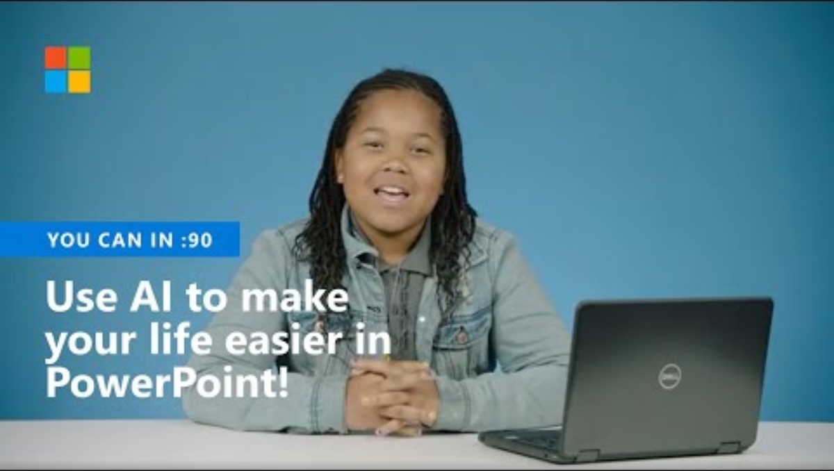
CoPilot Tools: PowerPoint
Power Point:
Designer: So Easy a 5th Grader Can Do It!
Rehearse with Real-Time Feedback
Present with Live Closed Captions (Translation)

Slide 9
CoPilot Tools: Excel
Analyze Data: Pivot Tables
Data from Pictures

Slide 10
CoPilot Tools: Word
Transcribing/Translating in Word
Word Designer

Slide 11
Thank you!

